Slide 1








START
Measure
NO
YES
24 hours Maintenance Cycle
END
decrease
delay

Slide 2





Servo
Motor
Load

Slide 3
Tooth fault
Motor shaft gear
Load shaft gear

Slide 4
Speed
Fault
peak
Rotation Angle
Dummy
Rotation
Fault time
time
Fault time
time

Slide 5
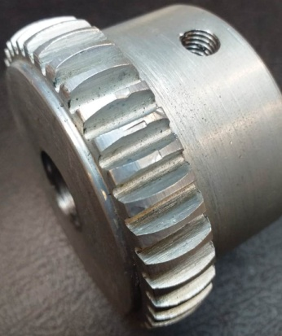

Slide 6
Speed Reference
Signal
iqref
PI
+
PID
Gate Signals
S
-
N
S
SVPWM
Inverter
A
B
C
idref
+
PID
-
W
θ

Slide 7



Speed Peak Math
Fault Indicator
Measured Speed
Speed Reference
Anti-peak Fed
Speed Reference Signal
Fault Duration
Rotor Position Angle

Slide 8
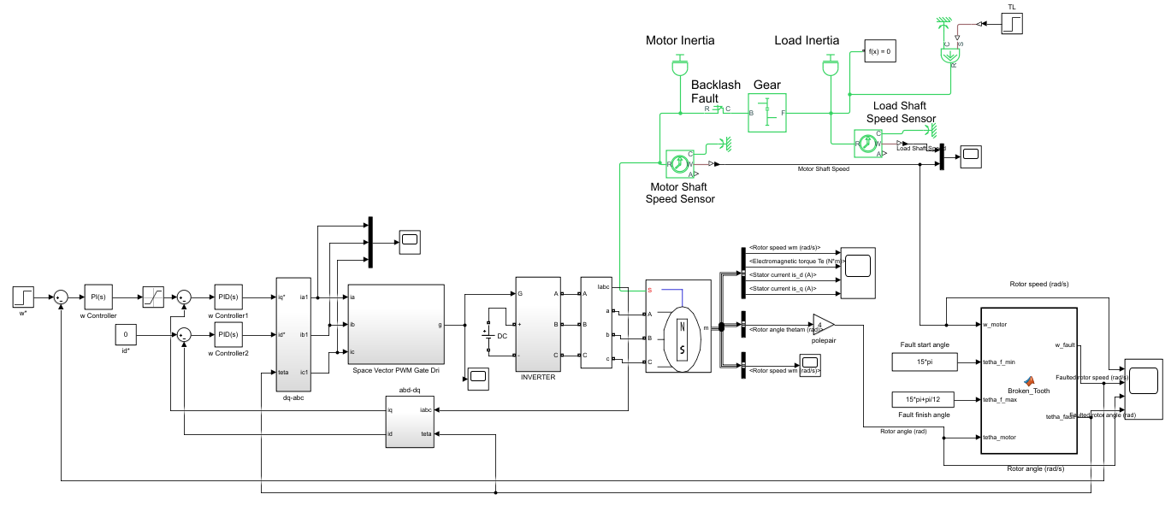

Slide 9
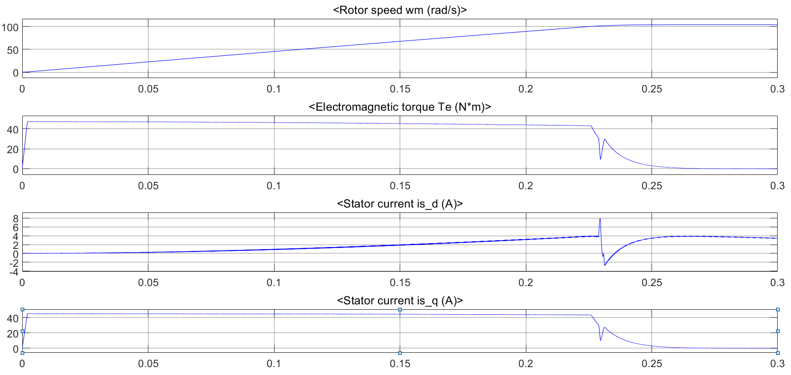

Slide 10
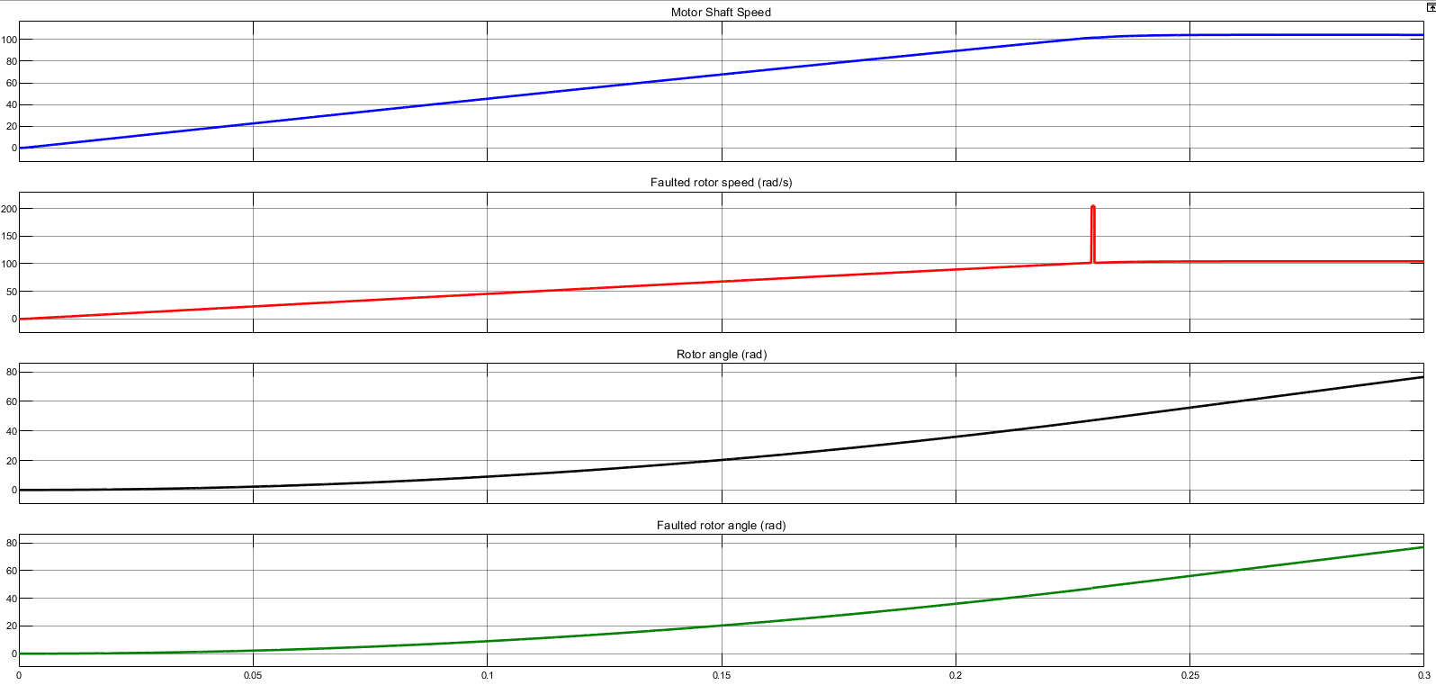

Slide 11
